Slide 1
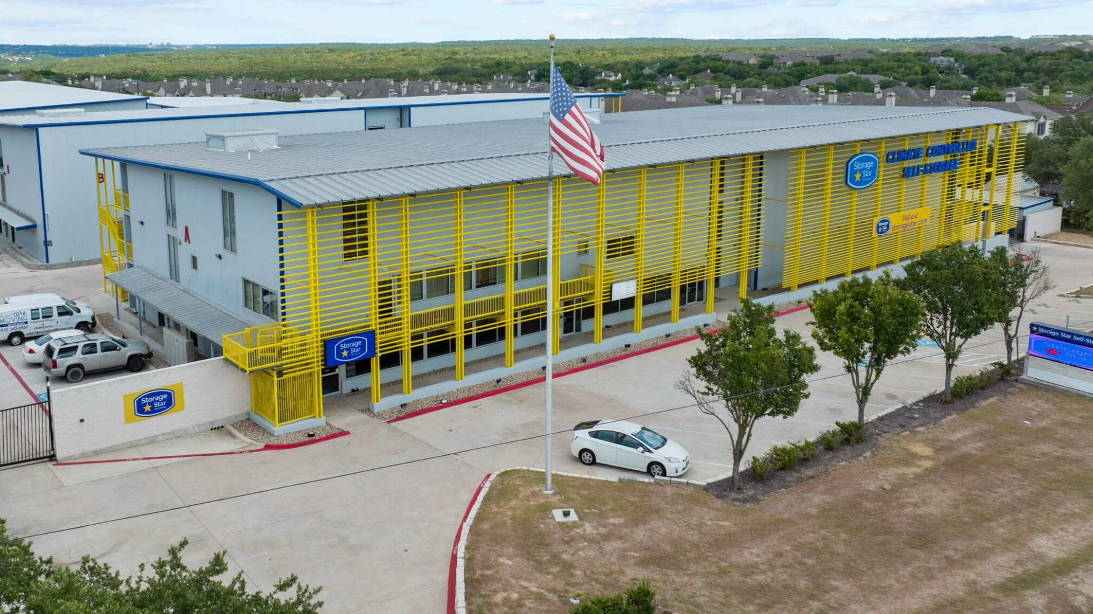
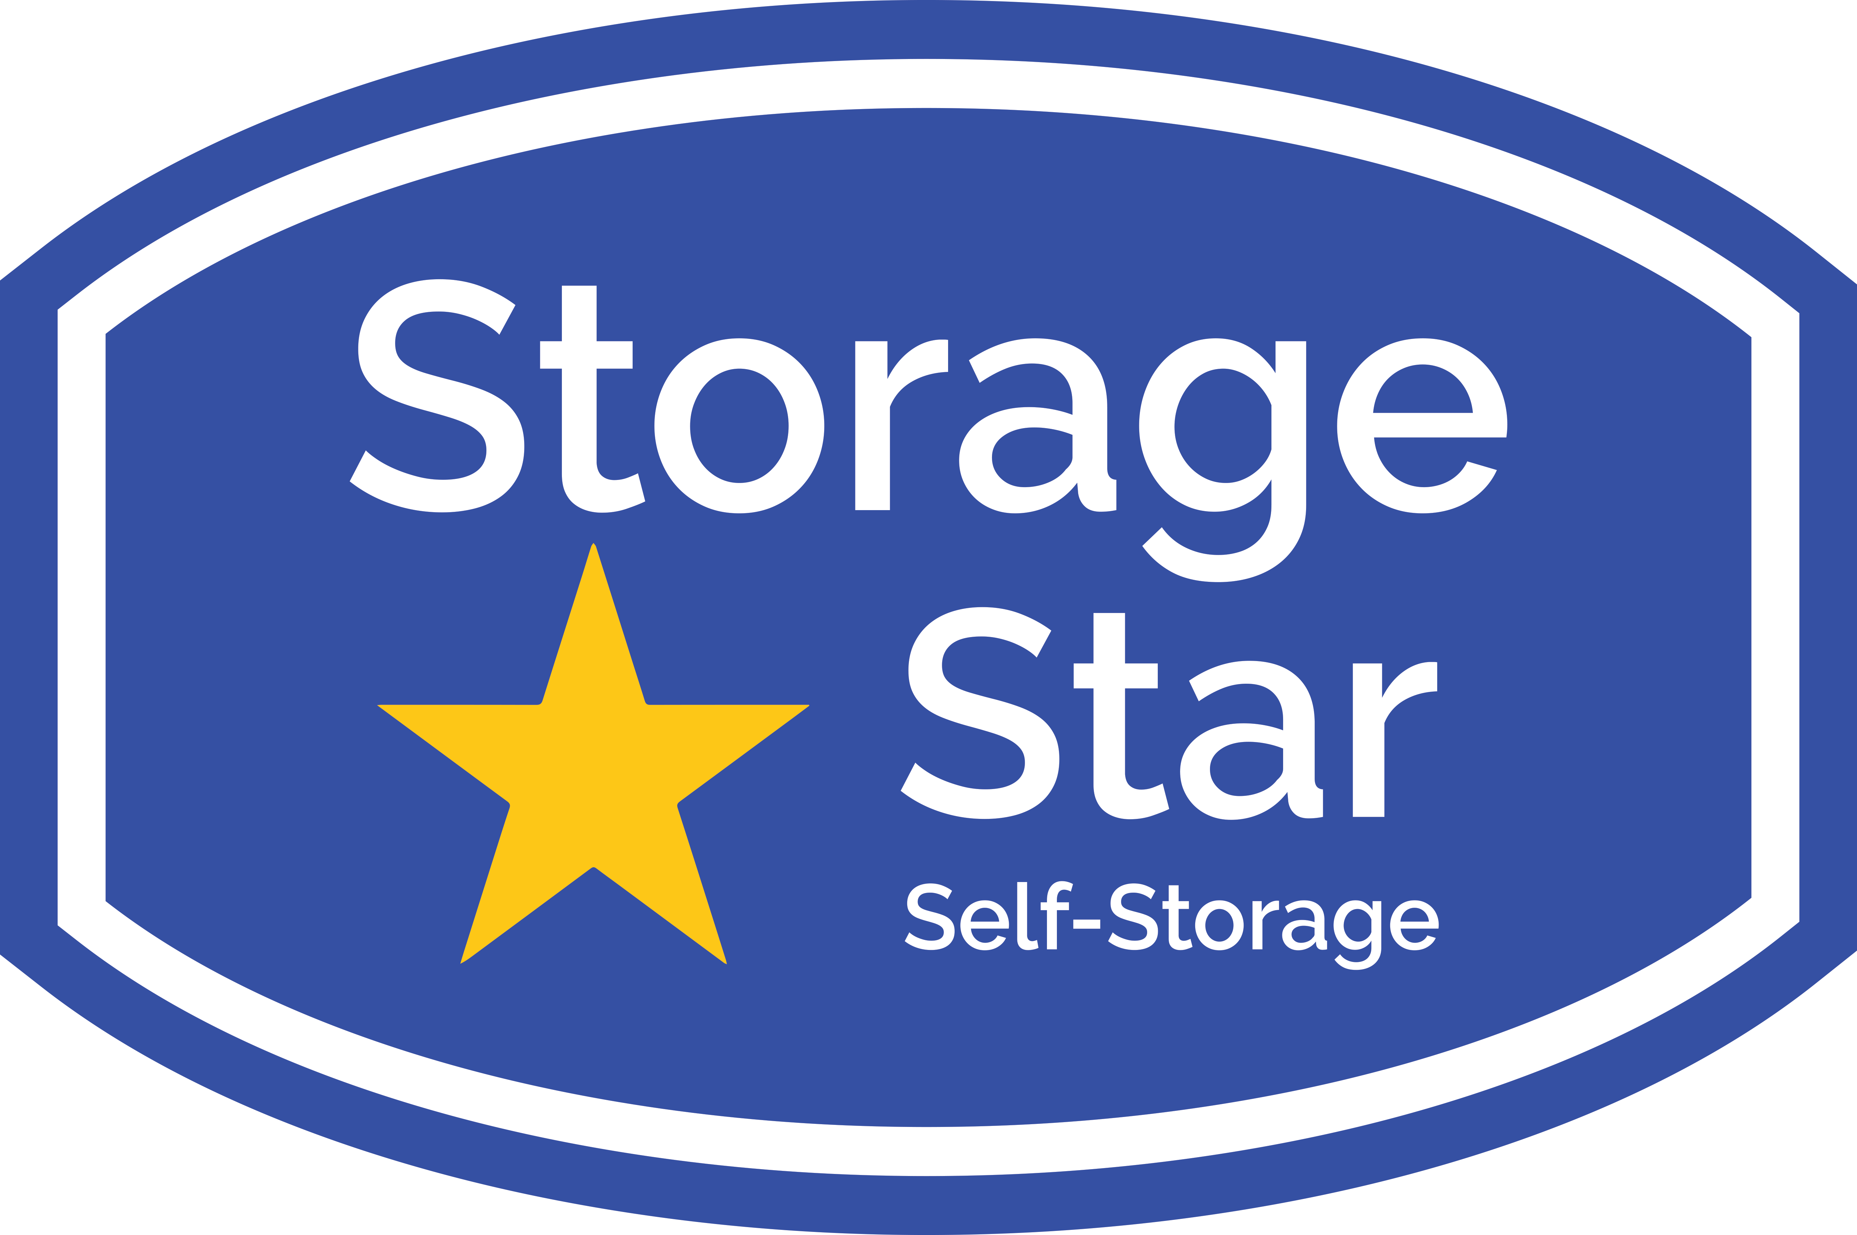
Power Pricing & Yearly Rent Dynamics
Kendall Keely
Summer Internship Capstone
August 2025
This document contains confidential and proprietary information about Storage Star and is intended solely for the recipient. It may not be distributed, copied, or disclosed without prior written consent from Storage Star. Unauthorized use is prohibited.

Slide 2
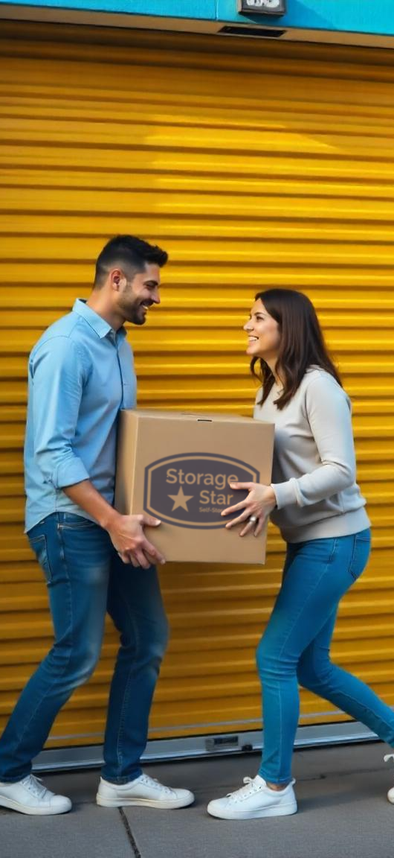
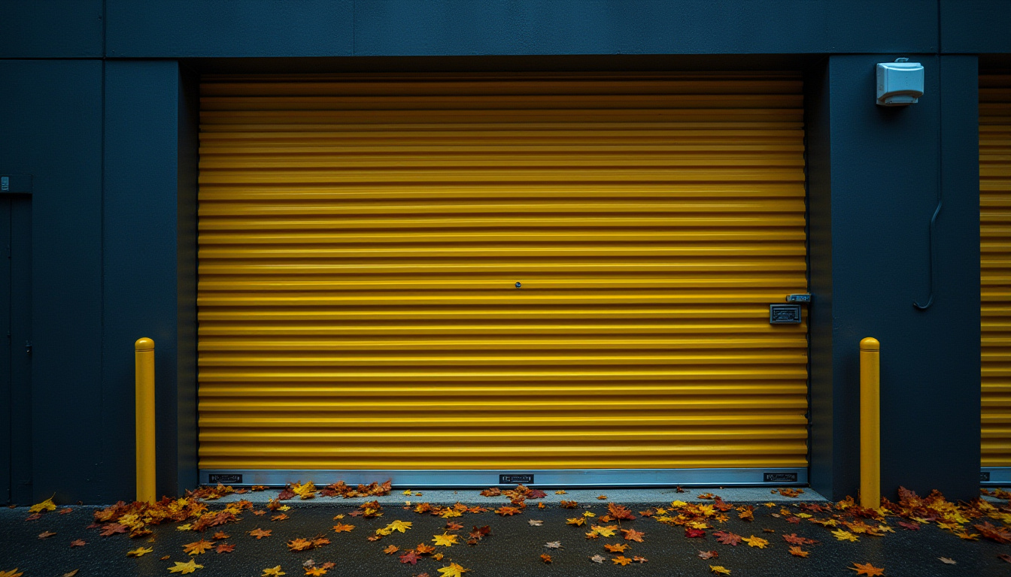


Agenda
1.
2.
3.
4.
5.
Executive Summary
Project Background
Power Model Analysis
Methodology
Results
Seasonality Trend Analysis
Methodology
Results
Next Steps for Research
This document contains confidential and proprietary information about Storage Star and is intended solely for the recipient. It may not be distributed, copied, or disclosed without prior written consent from Storage Star. Unauthorized use is prohibited.

Slide 3

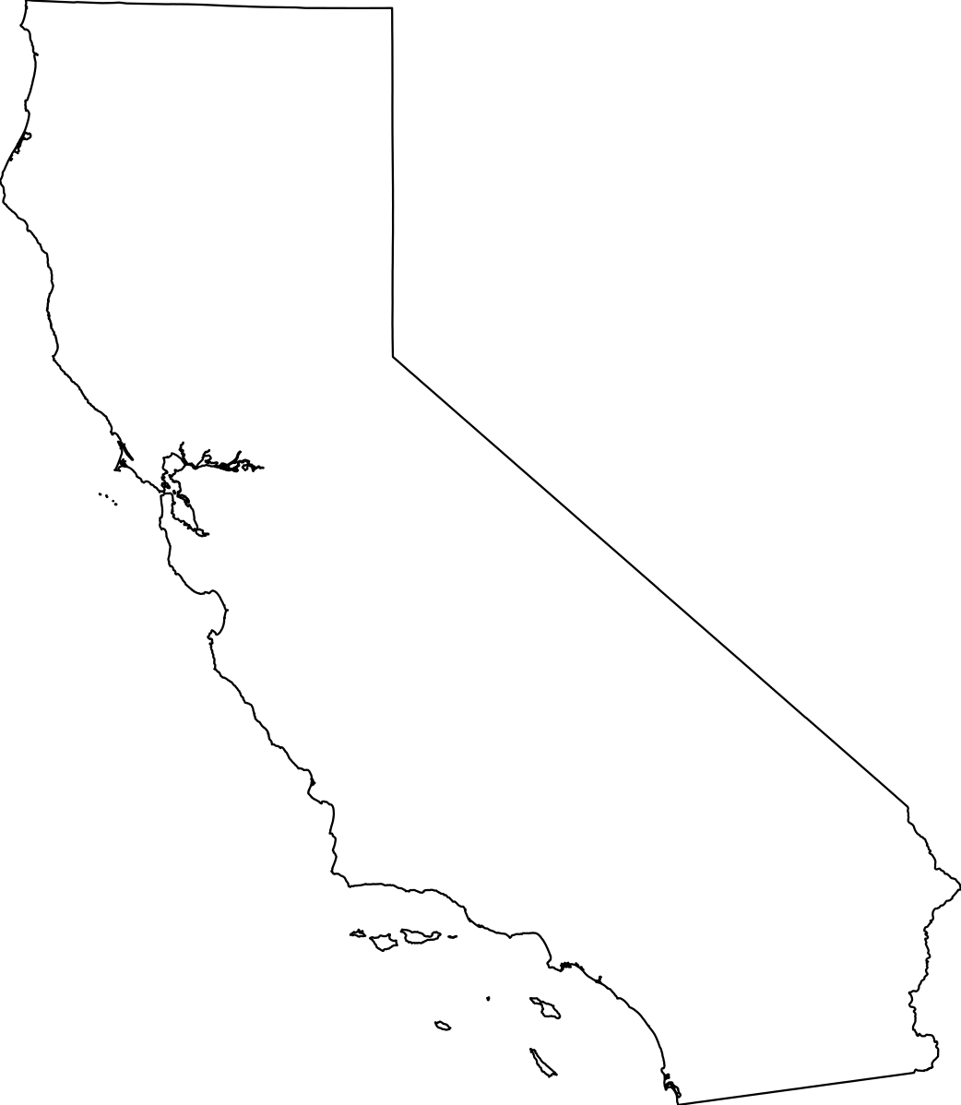
Executive Summary
Capstone Focus: Analyzed rent trends and rent per SF performance across four Storage Star markets, using power models and 90-day market averages
Market Covered:
Colorado: Denver, Fort Collins, & Loveland
Texas: Waters Park, Mopac, FM 620, & Pond Springs
Utah: Roy, Hooper, & Park City
California: Fairfield, Sonoma, & Napa
Objective: Identify pricing power, unit size sensitivities, and multi-year performance patterns to guide revenue strategy and market positioning
Climate units held stronger through 2022-2023, non-climate drive up units showed earlier and steeper declines, particularly for small-to-mid sizes under 200 SF.
Utah’s market hasn’t been affected as much compared to other markets from the recent down trend of rates. Non-climate ground-level rent per SF has increased since 2022. Utah has proven to be further along in recovery than other markets.
Only has non-climate drive up & non-climate ground floor units; rents in steady decline since 2022, smallest units hit hardest, but rents are starting to bottom-out.
Pricing peaked in 2022-2023 across both climate and non-climate drive up units, but non-climate drive up units declined more sharply beginning in 2024. Climate is also a premium in TX compared to other units.
This document contains confidential and proprietary information about Storage Star and is intended solely for the recipient. It may not be distributed, copied, or disclosed without prior written consent from Storage Star. Unauthorized use is prohibited.

Slide 4
Framing the Pricing Challenge– The Ask
The goal of my summer capstone was to better understand historical rate performance by year and what that means for future pricing decisions. To specify the scope of the capstone, there were three primary questions:
📊 How do rents per SF compare across four key markets: Texas, California, Colorado, and Utah?
🏙️ How do rents per SF change as unit sizes get larger or smaller?
💵 How do rents per SF differ for climate-controlled vs. non-climate vs. drive-up units?
Market
Climate Control
Pricing Power
Unit Size
By answering these questions, we can translate history into pricing guidance – helping us see where we still have pricing power, where we don’t, and how we can adjust strategy going forward.
This document contains confidential and proprietary information about Storage Star and is intended solely for the recipient. It may not be distributed, copied, or disclosed without prior written consent from Storage Star. Unauthorized use is prohibited.

Slide 5
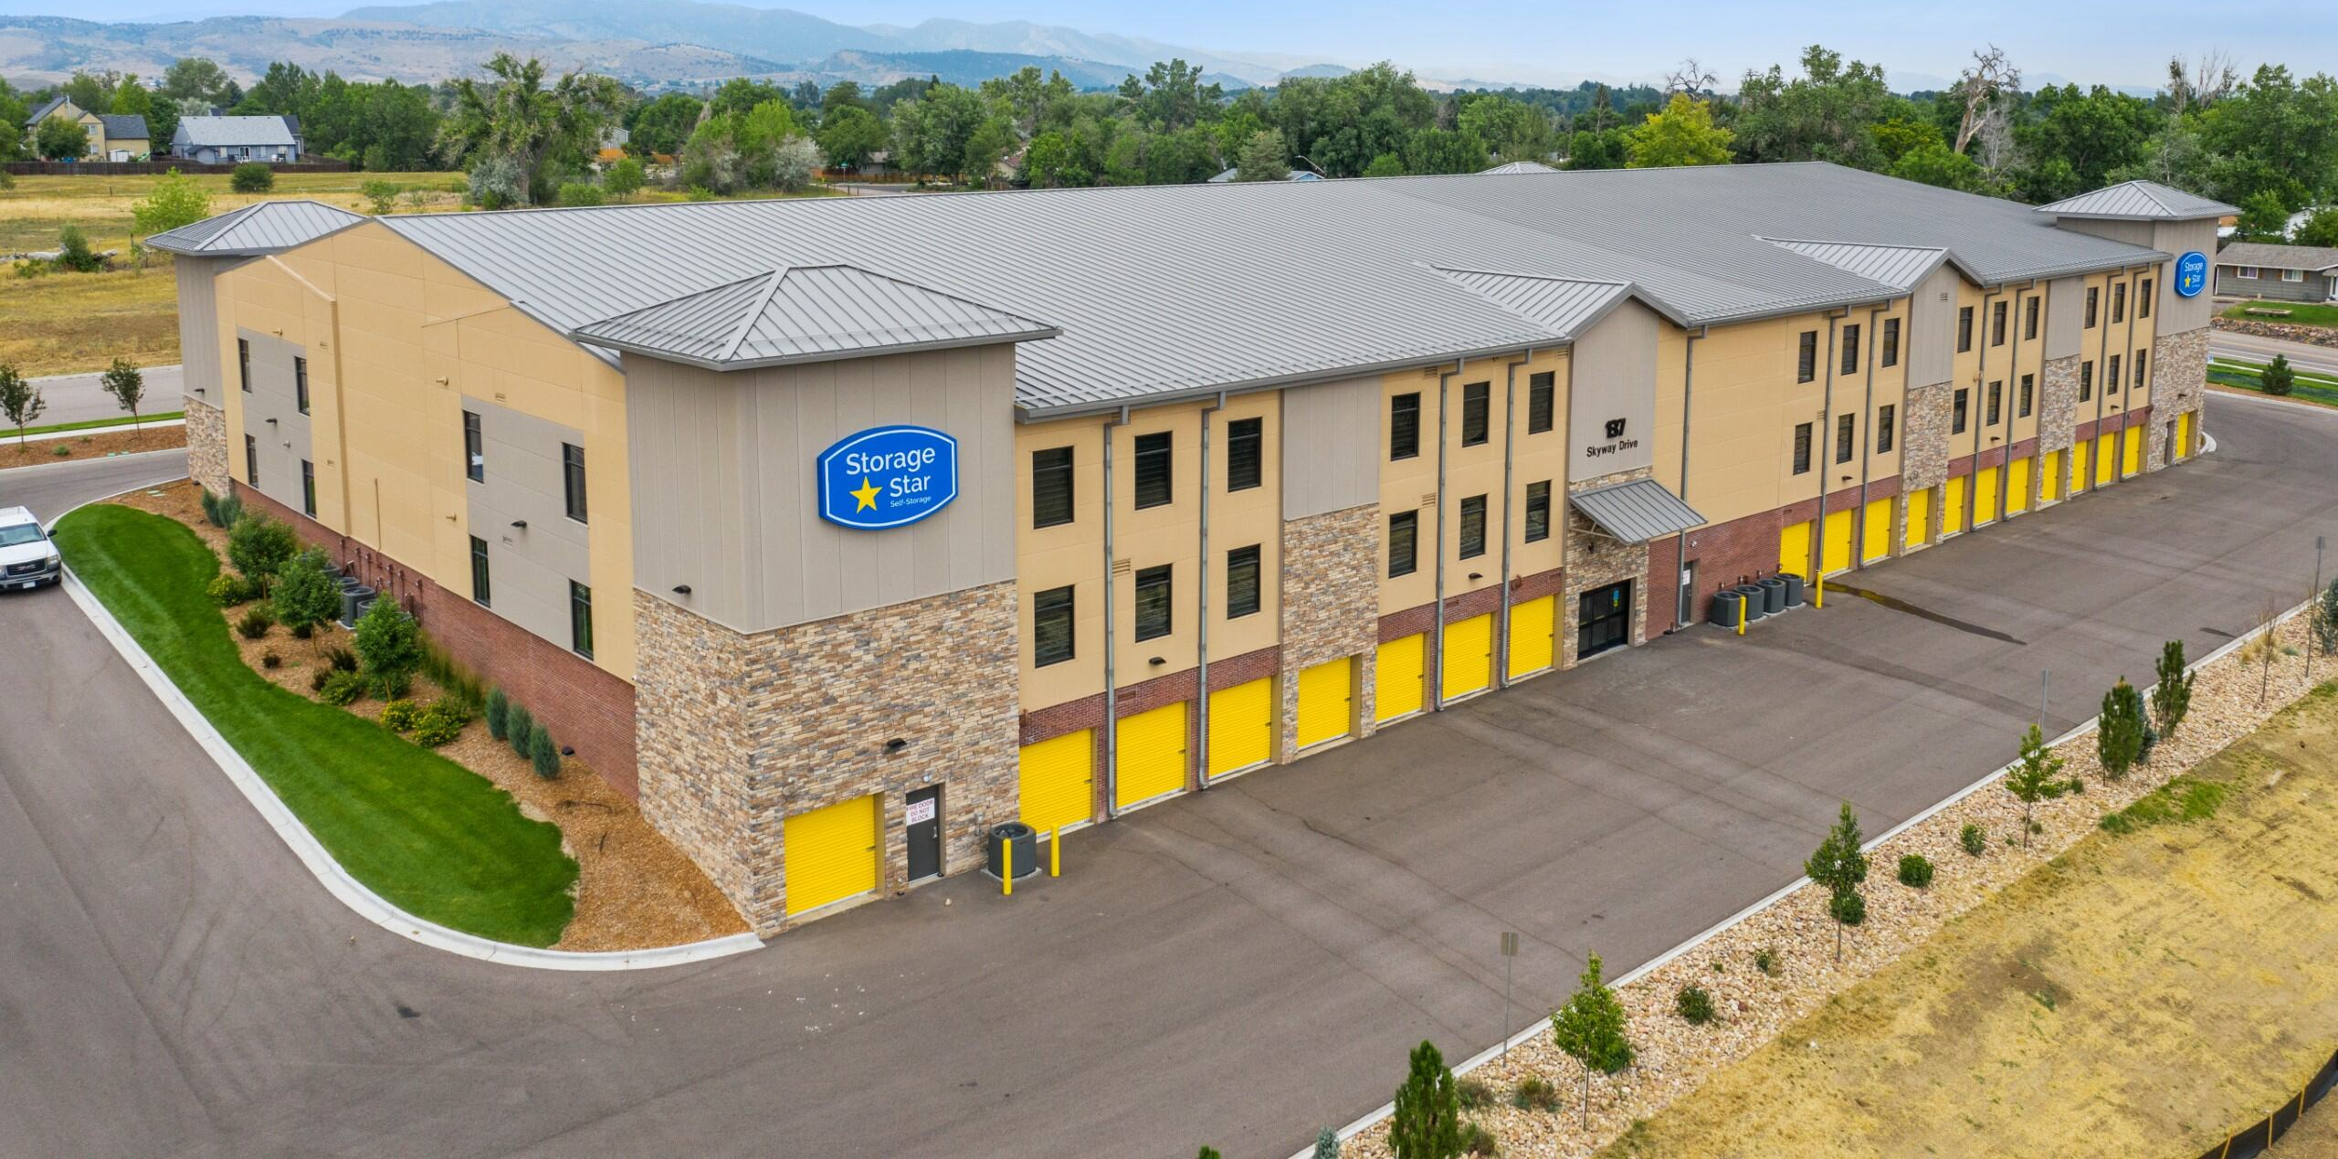
Power Models Analysis
This document contains confidential and proprietary information about Storage Star and is intended solely for the recipient. It may not be distributed, copied, or disclosed without prior written consent from Storage Star. Unauthorized use is prohibited.

Slide 6
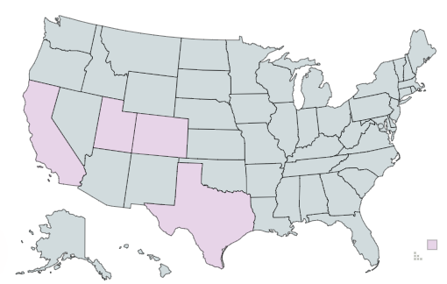
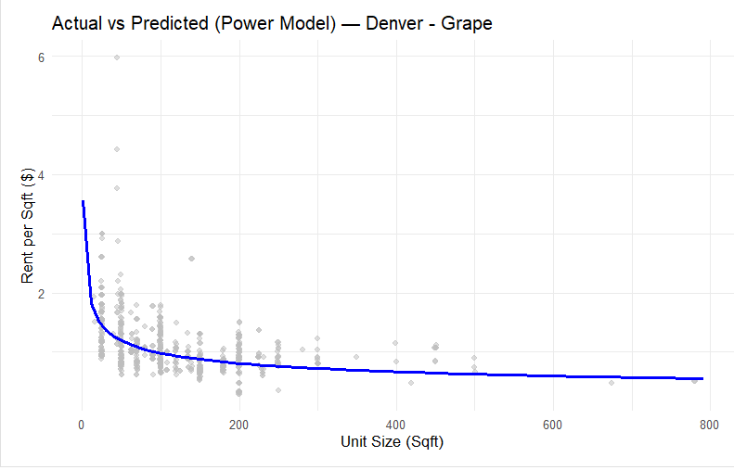
Methodology – Data & Model
Data & Scope
📍Markets
Texas → Waters Park, Mopac, FM 620, Pond Springs
Colorado → Denver, Fort Collins, Loveland
Utah → Roy, Hooper, Park City
California → Fairfield, Sonoma, Napa
📊 Filters
Rent per SF > 0
Unit size between 0 and 800 SF
Exclusions: CA wine lockers (code ends with “V”)
Outlier Control: Optional PSF hard caps applied in select markets (e.g., CO)
📈 Power Pricing Model
Equation: log(RPSF) = α + b * log(SQFT)
Grouping: one curve per Year (quarters pooled)
Guardrails: Skip weak groups → Requires at least 5 observations in the group and at least 3 distinct unit sizes
Outputs
Gray points = all cleaned transactions (≤ 800 SF)
Colored lines = fitted year curves, predicted across observed size range
This document contains confidential and proprietary information about Storage Star and is intended solely for the recipient. It may not be distributed, copied, or disclosed without prior written consent from Storage Star. Unauthorized use is prohibited.

Slide 7
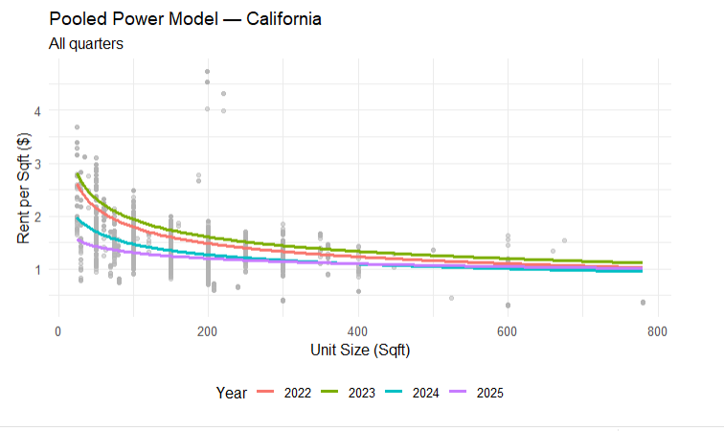
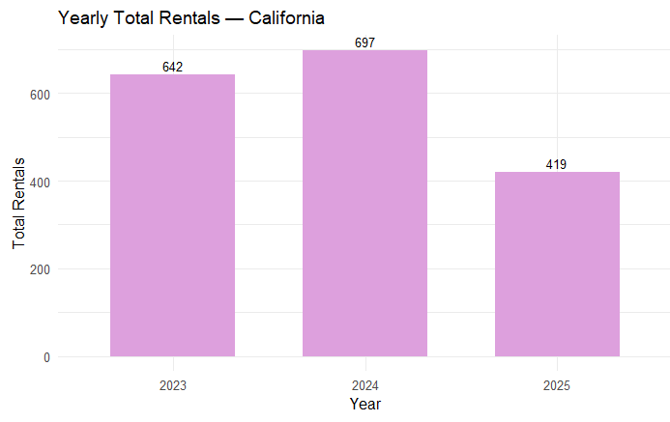
California – Overall Market Trends
Key Take Aways
Power model demonstrates that 2023 had the highest rent per SF with 2025 rates being generally the lowest
We are seeing rates starting to bottom out, as evidence by 2025 rates for larger units (>375 SF) surpassing same size rents from 2024. However, rents for smaller unit sizes are lower in 2025 compared to 2024.
Total rentals for 2025 is on track to align with 2023 rentals
Data shown from 2025 is through 08-12-2025
Data shown from 01-01-2023 onwards for yearly total rentals graphs as previous years were in lease-up
This document contains confidential and proprietary information about Storage Star and is intended solely for the recipient. It may not be distributed, copied, or disclosed without prior written consent from Storage Star. Unauthorized use is prohibited.

Slide 8
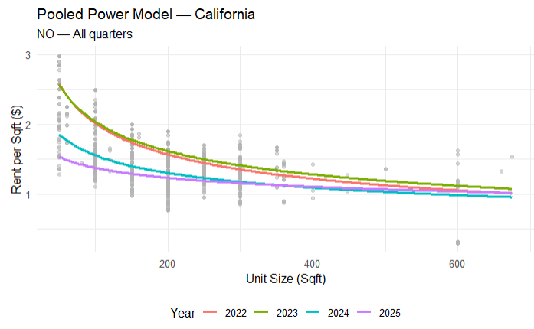
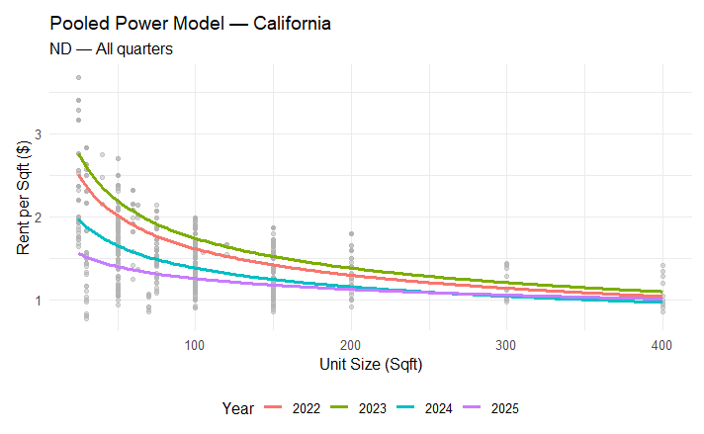
California – Drive-Up vs. Interior
Non-Climate Drive-Up
Non-Climate Ground Level
Key Take Aways
Spread between drive-up units is a lot tighter between 2022 and 2023, same with 2024 and 2025
In 2023 we saw growth in rent per SF for both non-climate drive-up & non-climate ground level units, however, there was still a drop in years following
For both drive-up and ground level units, rates are starting to bottom out, as seen by 2025 rates for larger units surpassing same size rents from 2024 (at around 375 SF for non-climate drive-up and ~250 SF for non-climate ground level units). However, rents for smaller unit sizes are lower in 2025 compared to 2024.
Data shown from 2025 is through 08-12-2025
This document contains confidential and proprietary information about Storage Star and is intended solely for the recipient. It may not be distributed, copied, or disclosed without prior written consent from Storage Star. Unauthorized use is prohibited.

Slide 9
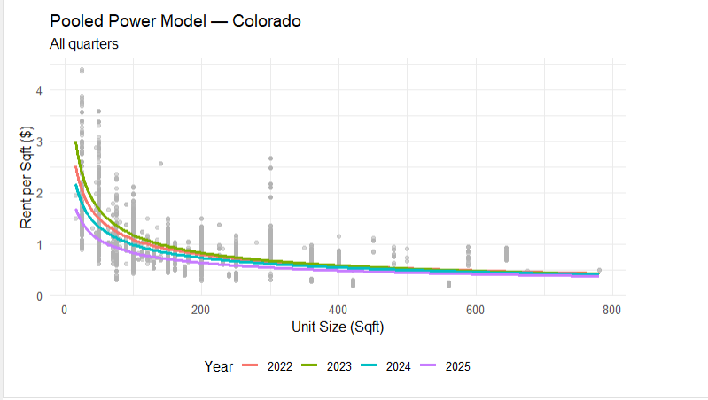
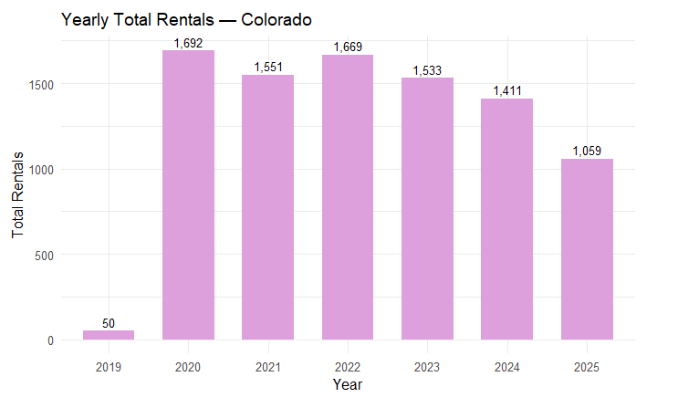
Colorado – Overall Market Trends
Key Take Aways
The power model for Colorado demonstrates how smaller units are more of a premium, indicated by the left tails curving up with a steeper slope
The gap between yearly rent curves has declined since 2023 and prices have yet to bottom out, indicating a slower-start to recovery
Total rentals for 2025 is on track to align with 2020 rentals
Data shown from 2025 is through 08-12-2025
This document contains confidential and proprietary information about Storage Star and is intended solely for the recipient. It may not be distributed, copied, or disclosed without prior written consent from Storage Star. Unauthorized use is prohibited.

Slide 10
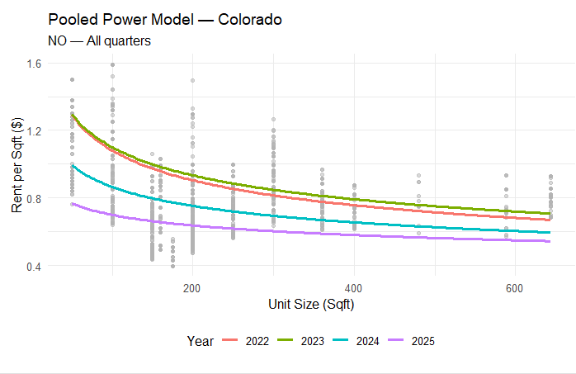
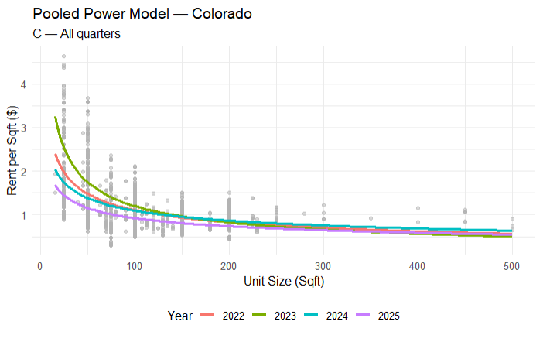
Colorado – NCC vs. CC Trends
Non-Climate
Climate
Key Take Aways
Climate-controlled (CC) units command a clear premium over non-climate controlled (NCC) units, especially for units smaller than 100 SF that have a greater than 2x premium
Both CC and NCC rents have softened since 2022, and although CC units show a more severe drop in rent per SF, it has also shown signs of recovery that NC units haven’t yet
Rent per SF in 2025 surpasses that of 2023 for CC units greater than 350 SF, indicating rates are bottoming out & expecting an uprise in rates
Data shown from 2025 is through 08-12-2025
This document contains confidential and proprietary information about Storage Star and is intended solely for the recipient. It may not be distributed, copied, or disclosed without prior written consent from Storage Star. Unauthorized use is prohibited.
Notes:
Non-climate hasn’t inflected yet but climate showed a more severed drop, however, has bottomed out
rates are bottoming out, so expecting more of an up-rising in rates → bottom of the market has riser

Slide 11
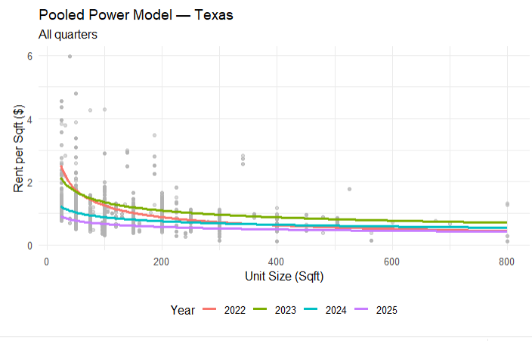
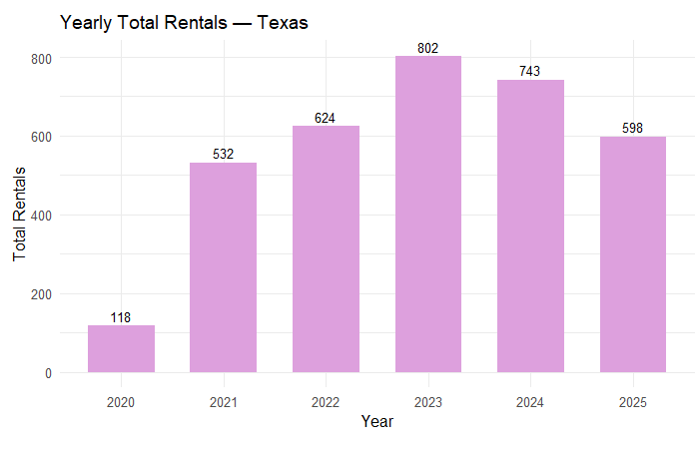
Texas – Overall Market Trends
Key Take Aways
2025 yearly total rentals are expected to surpass 2023 by ~ 19% (~956 rentals), signaling demand is still strong despite weaker pricing power
Texas depicts the most extreme example of the power curves flattening
Rent curves peaked in 2022-2023 and have since declined, with units less than 100 SF showing the steepest decline. Larger units (>400 SF) show flatter trend lines
Data shown from 2025 is through 08-12-2025
This document contains confidential and proprietary information about Storage Star and is intended solely for the recipient. It may not be distributed, copied, or disclosed without prior written consent from Storage Star. Unauthorized use is prohibited.

Slide 12
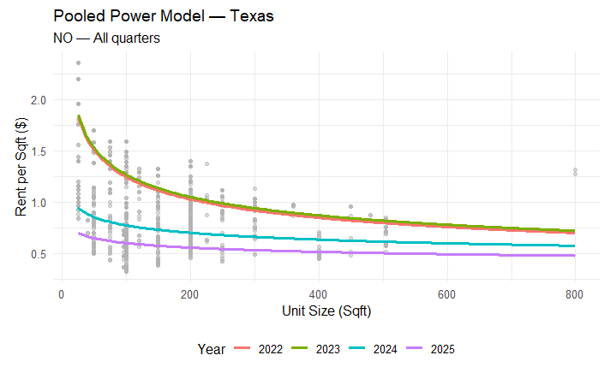
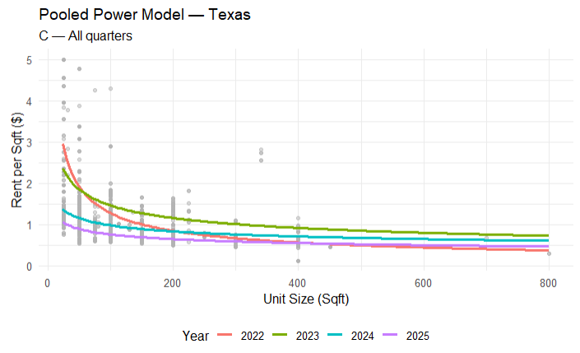
Texas – NCC vs. CC Trends
Non-Climate
Climate
Key Take Aways
As seen with Colorado, climate-controlled (CC) units command a clear premium over non-climate controlled (NCC) units, especially for units smaller than 100 SF
For both CC and NCC, 2024 and 2025 are the flattest curves we have seen, with the largest drop between 2023 and 2024 for NCC units. For NCC, it has dropped over 50% from 2023 to 2025
Both CC and NCC rents have softened since 2022 with larger CC units having higher rent per SF than 2022 prices. This means we are seeing a recovery on CC units that we haven’t seen on NCC units
Data shown from 2025 is through 08-12-2025
This document contains confidential and proprietary information about Storage Star and is intended solely for the recipient. It may not be distributed, copied, or disclosed without prior written consent from Storage Star. Unauthorized use is prohibited.

Slide 13
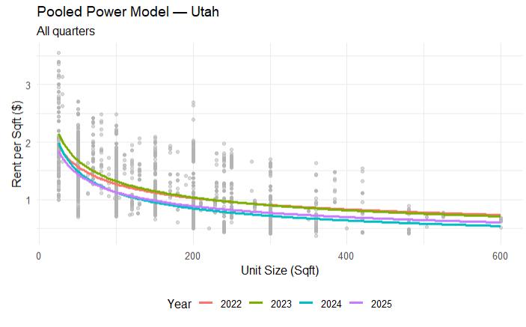
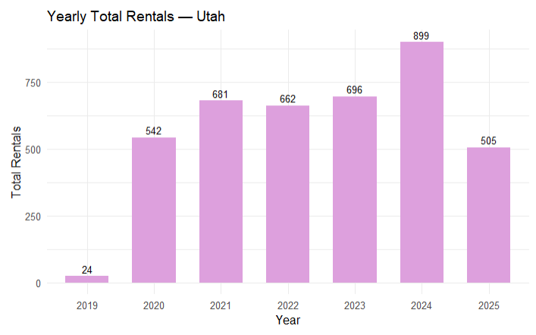
Utah – Overall Market Trends
Key Take Aways
Utah rent per SF has remained the most consistent over the years, with the power model demonstrating that 2025 rent per SF closely follows 2024 rent per SF trends
Rates are starting to bottom out even earlier in Utah, as evidence by 2025 rates for units greater than 100 SF surpassing same size rents from 2024, meaning Utah is further along in the recovery compared to other markets
2025 rentals are expected to surpass 2023 rentals with ~ 808 total units
Data shown from 2025 is through 08-12-2025
This document contains confidential and proprietary information about Storage Star and is intended solely for the recipient. It may not be distributed, copied, or disclosed without prior written consent from Storage Star. Unauthorized use is prohibited.

Slide 14
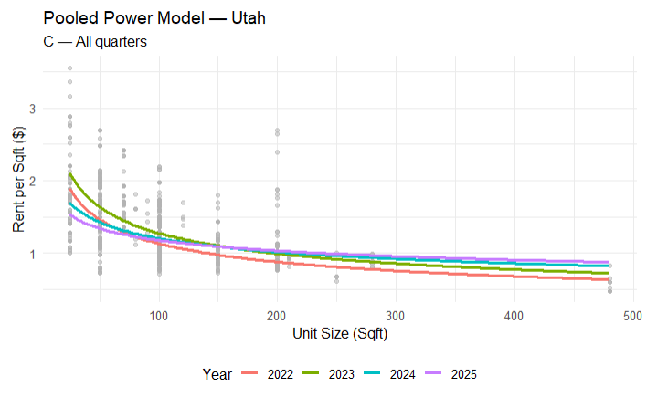
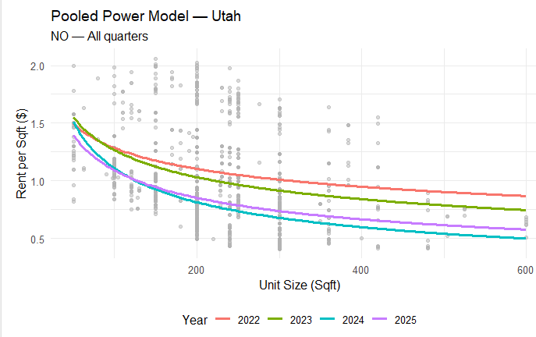
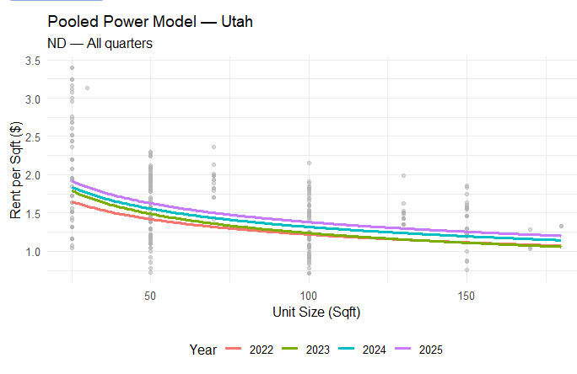
Utah – CC vs. NC Ground Level vs. NC Drive-Up
Key Take Aways
Climate controlled units command the highest premium, especially for smaller sizes, and remain more stable compared to non-climate segments
Non-climate ground level for 2025 has already achieved the highest rent per SF compared to previous years
Non-climate drive-up units have also declined in rent per SF, however, it bottoms out at ~120 SF, indicating an increase in rent per SF this year
Climate
Non-Climate Drive-Up
Non-Climate Ground Level
Data shown from 2025 is through 08-12-2025
This document contains confidential and proprietary information about Storage Star and is intended solely for the recipient. It may not be distributed, copied, or disclosed without prior written consent from Storage Star. Unauthorized use is prohibited.

Slide 15
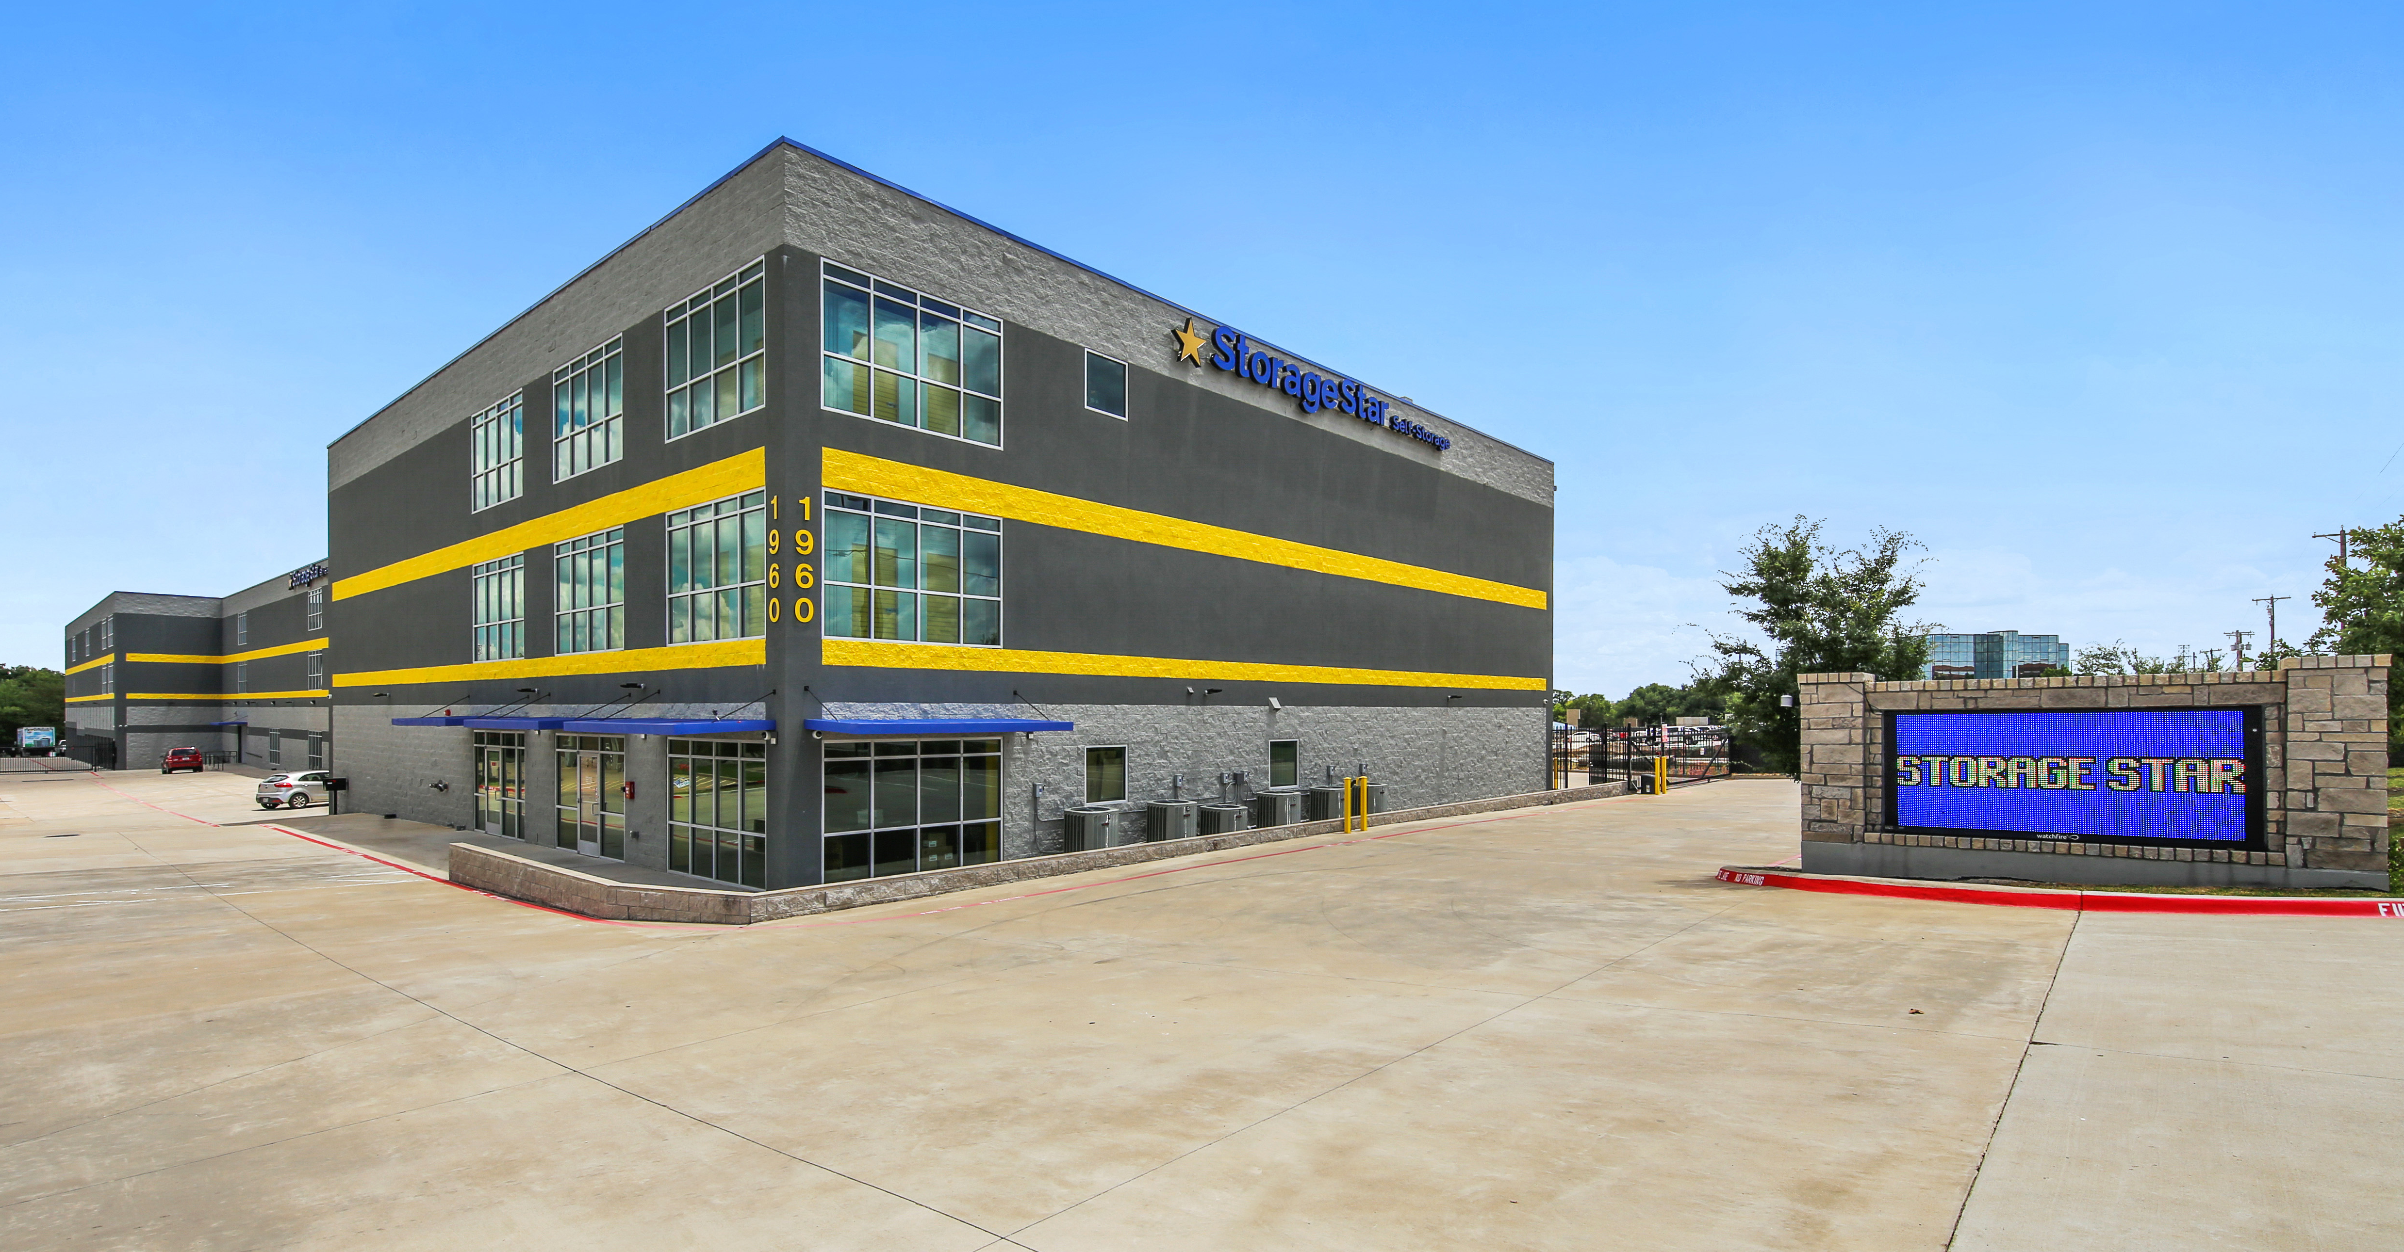
Seasonality Trends Analysis
This document contains confidential and proprietary information about Storage Star and is intended solely for the recipient. It may not be distributed, copied, or disclosed without prior written consent from Storage Star. Unauthorized use is prohibited.

Slide 16
Methodology – Seasonality & Aggregation
Seasonality of Flow (Rentals &Vacates)
🗓️ Windowing
Each 1st of the month is used as a start date → builds a 90-day window → sums rentals and vacates within the window to get a store total
📊 Averaging & Aggregation
Averages across years within each 90-day window, then sums across stores to produce market-level monthly totals
90-Day Window
Store Totals
1st of Month
Market Totals
Yearly Aggregation
👑
👑
Synchronized 90-day rentals/vacates deliver an apples-to-apples read on demand seasonality
This document contains confidential and proprietary information about Storage Star and is intended solely for the recipient. It may not be distributed, copied, or disclosed without prior written consent from Storage Star. Unauthorized use is prohibited.

Slide 17
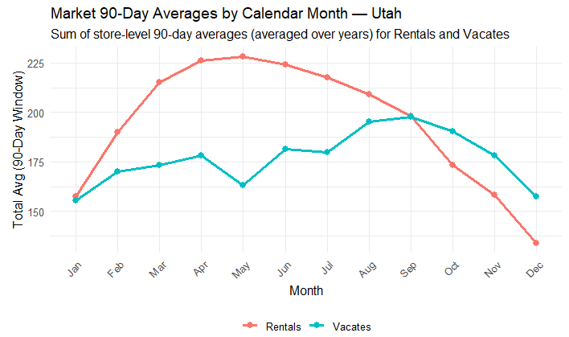
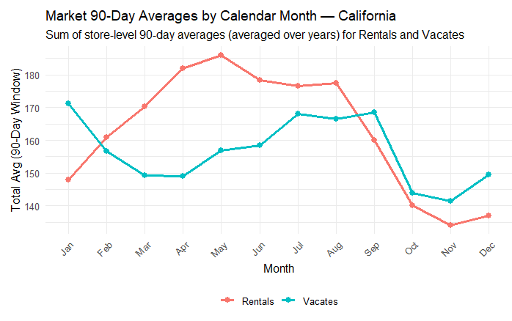
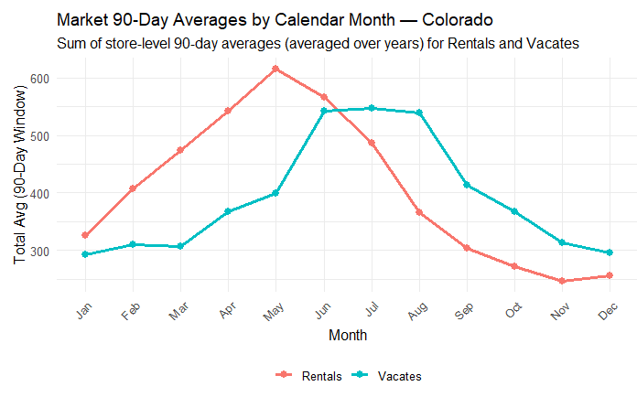
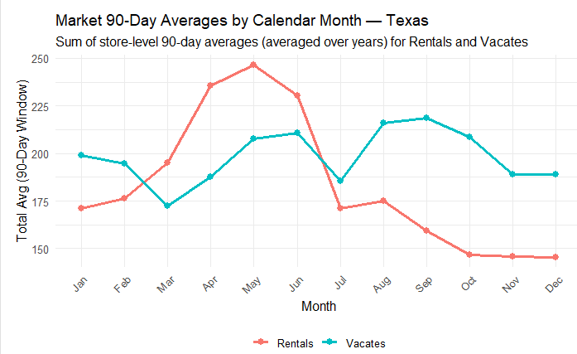
Seasonality Trends → Rentals & Vacates
This document contains confidential and proprietary information about Storage Star and is intended solely for the recipient. It may not be distributed, copied, or disclosed without prior written consent from Storage Star. Unauthorized use is prohibited.

Slide 18
Results
Pricing trends are mixed; With only non-climate drive-up units and non-climate ground floor units, rents have steadily declined since 2022, however, have started to bottom out. We have had more rentals this year compared to previous years at this time
Rate compression is most evident in smaller unit sizes, and excluding wine lockers highlights the downward trend as unit size increases
California
Climate controlled units are more of a premium than non-climate units. Climate-controlled held stronger through 2022-2023, maintaining higher rents per SF
Non-climate units showed earlier and steeper declines, particularly for small-to-mid sizes under 200 SF. The spread between climate and non-climate pricing demonstrates that climate control provides a cushion for pricing power
Colorado
Pricing peaked in 2022-2023 across both climate and non-climate units, but non-climate units declined more sharply beginning in 2024. Climate is also more of a premium in Texas compared to other units, achieving a higher rent per SF on average.
Seasonal rental demand shows strong peaks in spring/ early summer , with vacates dominating in the months July-December
Texas
Utah is the only market with all three product types: climate, non-climate drive-up, non-climate ground level; Climate-control has proven the most resilient, maintaining higher rent per square foot through 2024. Drive-up units have softened since 2022, particularly in smaller sized units, where ground-level units have increased in rent per SF
Utah’s declines are less severe than Texas or Colorado , reflecting relatively steadier demand. Yearly rental volumes peaked in 2024, with 2025 looking to surpass previous years in rentals
Utah
This document contains confidential and proprietary information about Storage Star and is intended solely for the recipient. It may not be distributed, copied, or disclosed without prior written consent from Storage Star. Unauthorized use is prohibited.

Slide 19
Next Steps for Research
Further Analysis
📊 Integrate demand signals
Join rentals, vacates, and occupancy to Year x Quarter power fits
Model take-rate by size vs posted PSF & available inventory
Compare to market-trends and competitors rents per SF to reveal where Storage Star is compared to the broader market.
⚖️ Constrained vs. Unconstrained demand
Unconstrained: Price vs demand (ignore supply caps) to see pure price sensitivity
Constrained: Add occupancy/inventory limits -> optimize revenue under real availability
🤖 Updating The Power Models
Automate weekly refits -> alert when seasonal drift detected
Dashboard: curve vs last quarter + revenue impact
Unconstrained Demand
Constrained Demand
New Power Models
Dashboard Delivery
Integrate Demand Signals
Model Take-Rates
This document contains confidential and proprietary information about Storage Star and is intended solely for the recipient. It may not be distributed, copied, or disclosed without prior written consent from Storage Star. Unauthorized use is prohibited.

Slide 20
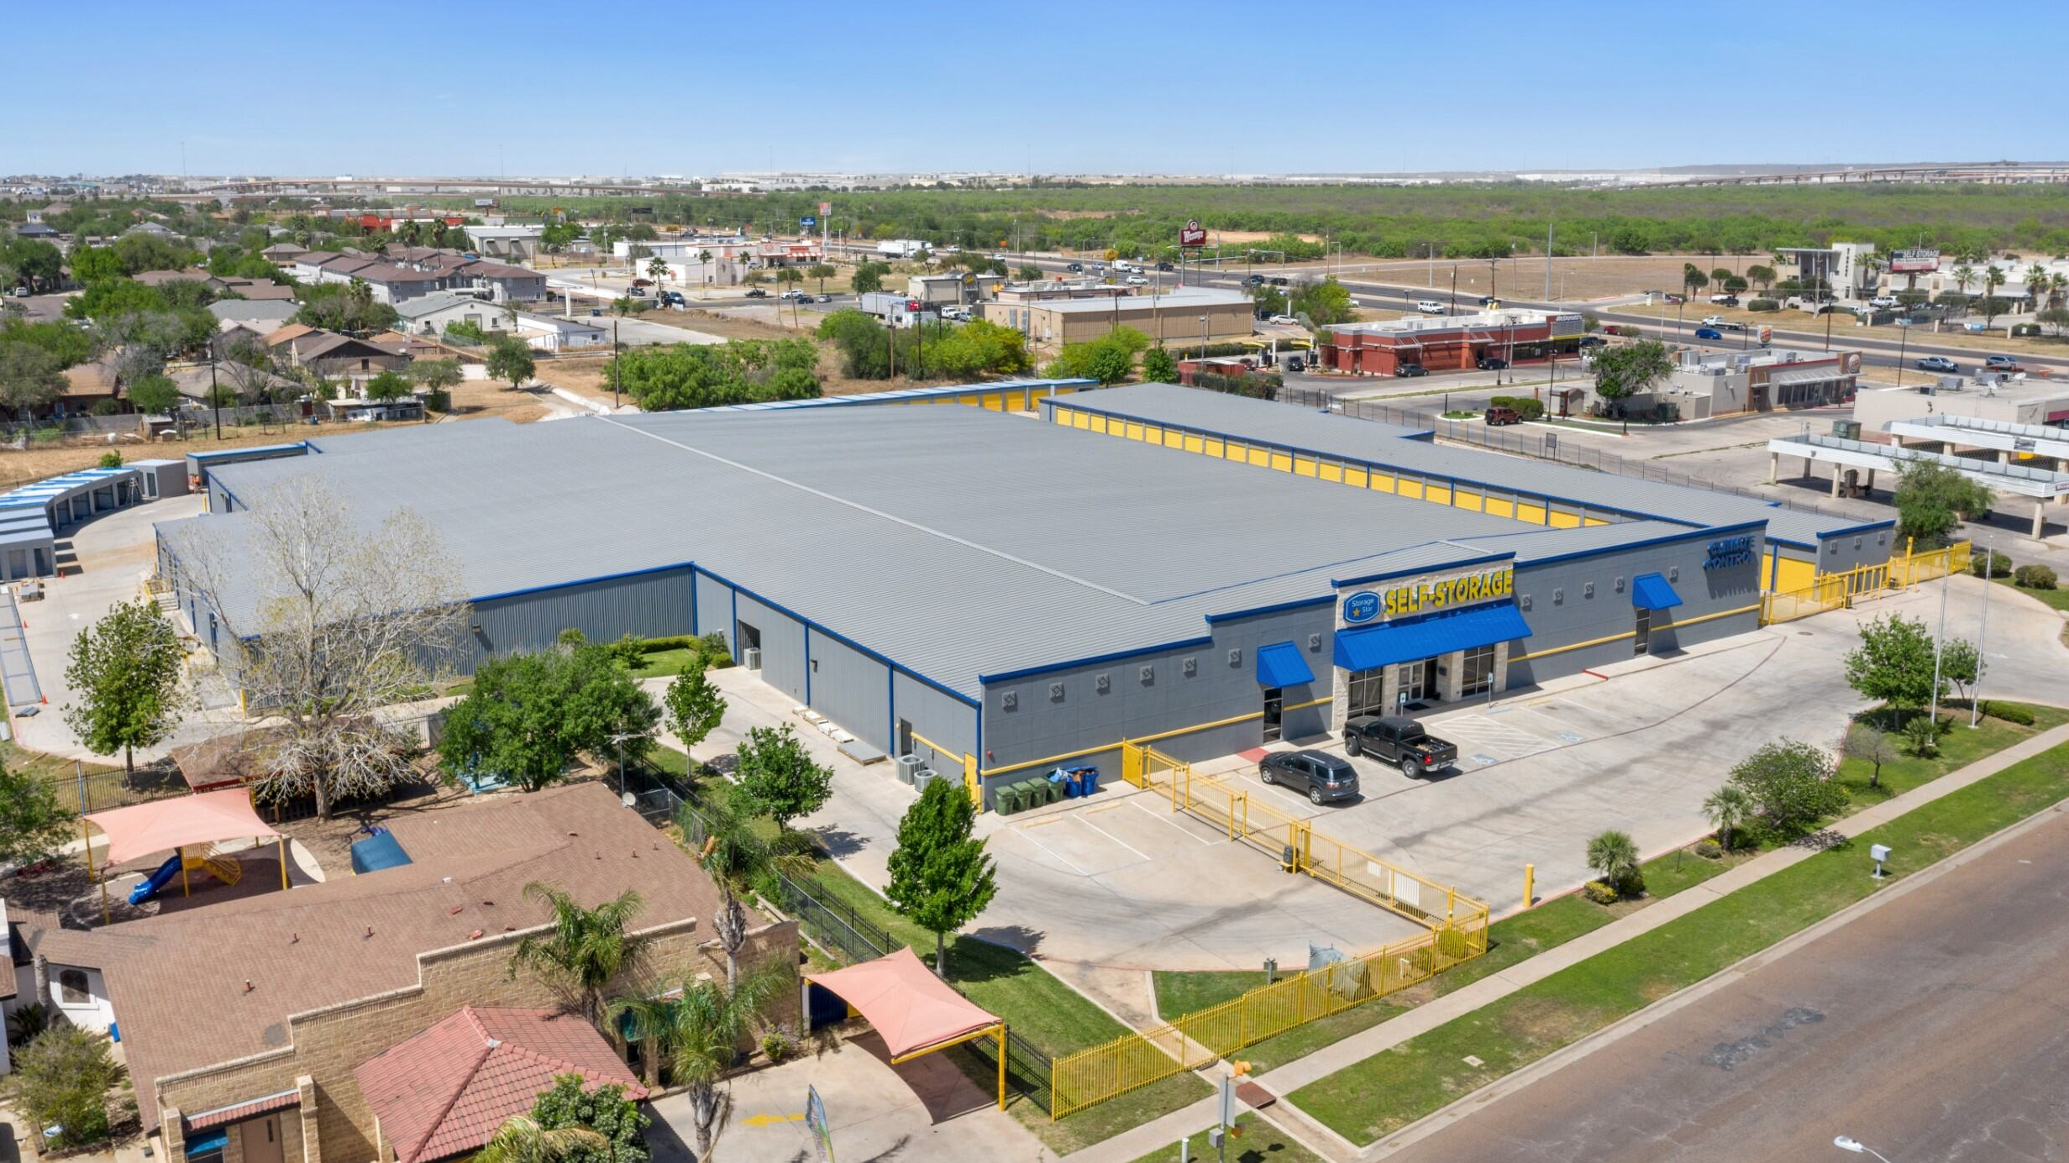
Q&A
This document contains confidential and proprietary information about Storage Star and is intended solely for the recipient. It may not be distributed, copied, or disclosed without prior written consent from Storage Star. Unauthorized use is prohibited.

Slide 21
Appendix
Methodology
Segmentation
Uses pooled unit-level data across stores within each state pulled from SQL
Fit guardrails: requires ≥ 5 rows and ≥ 3 distinct unit sizes
90-day rolling windows: each 1st of month start -> sum rentals/vacates over 90 days
Averaging: averages across years at store x month, then sums to market totals
CDN/CEN/CON = Climate-Controlled Units
NON = Non-Climate Drive-Up Units
NDN = Non-Climate Ground Floor Units
California excludes wine lockers from analysis
Interpretation Notes
Smaller units show the greatest price sensitivity
Climate-controlled typically maintains higher $/sqft but still shows compression post-2022
Year-over-year curves highlight relative pricing power shifts
This document contains confidential and proprietary information about Storage Star and is intended solely for the recipient. It may not be distributed, copied, or disclosed without prior written consent from Storage Star. Unauthorized use is prohibited.

Slide 22
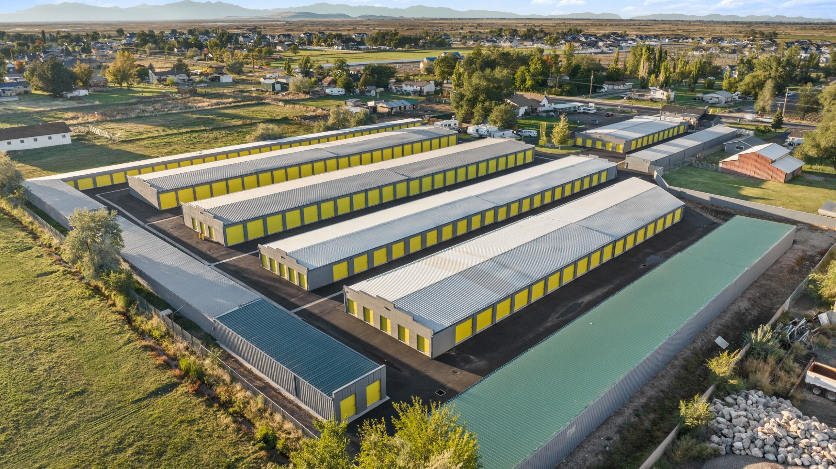
Thank You
Kendall Keely
Capstone Project 2025
This document contains confidential and proprietary information about Storage Star and is intended solely for the recipient. It may not be distributed, copied, or disclosed without prior written consent from Storage Star. Unauthorized use is prohibited.

